Slide 1
Thermochronological constraints on the timing and magnitude of Miocene and Pliocene extension in the central Wassuk Range, western Nevada
Daniel F. Stockli, Benjamin E. Surpless, and Trevor A. Dumitru
James McNeil

Slide 2
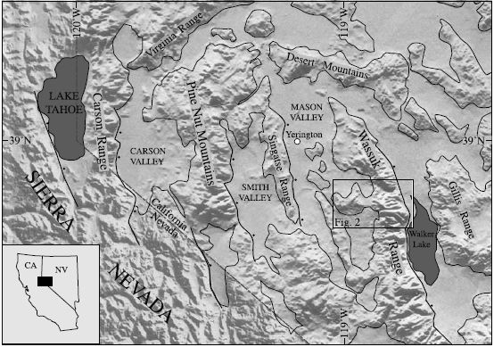
Overview
Study area - Central Wassuk Range
Series of intact, ~60° westward tilted fault blocks
Quartz monzonite
Up to ~8.5 km of exposed pre-extensional upper crust

Slide 3
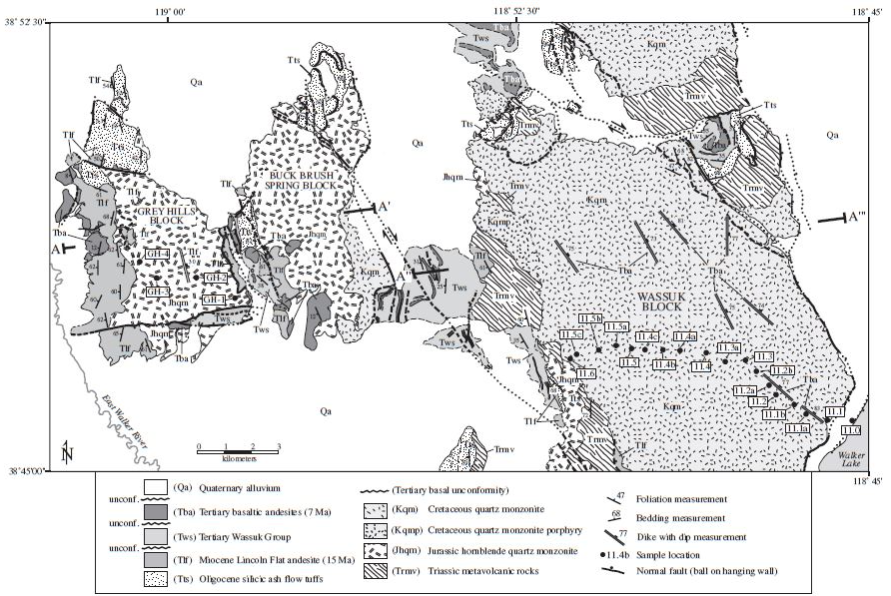
Geology
NNW normal faults
3 tilted blocks
Brittle deformation dominant

Slide 4
Geology
Exposed intact upper crustal section
Wassuk
~8.5 km
Gray Hills
~3 km
Transects

Slide 5
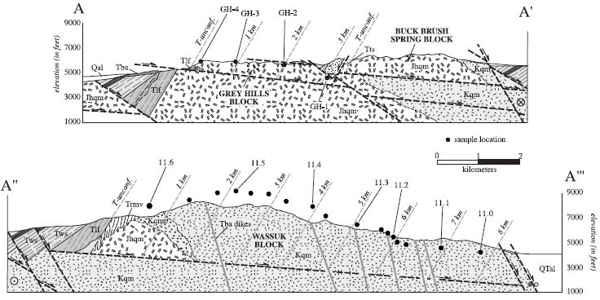
Geology
Total of 22 thermochron samples from Gray Hills and Wassuk fault blocks
Lack of samples from Buck Brush Spring block
Notes:
Buck Brush Spring Block – NO SAMPLES because of extensive hydrothermal alteration of Jurassic quartz monzonite
Only 4 samples taken from Grey Hills Block because of limited structural depths exposed
Sampling was focused on Wassuk fault block because it exposes the largest structurally intact block

Slide 6
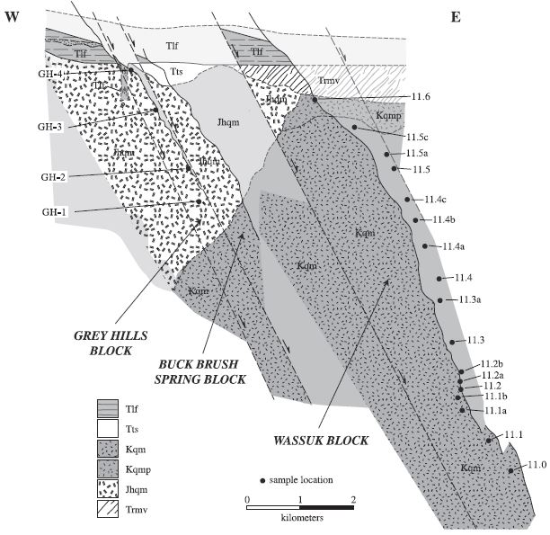
Geology
Reconstruction of central Wassuk Range pre-large magnitude extension ~15 Ma
Onset of large-magnitude extensional faulting @ ~15 Ma
Tlf – Miocene Lincoln Flat andesite ~15.0-14.8 Ma (youngest pre-extensional marker)
~60° post-15 Ma westward tilt
>200% extension (palinspastic restoration)
Notes:
1. Rotation of early high angle normal faults to low angle normal faults (SUBHORIZONAL)
2. Tertiary extensional faulting postdates the extrusion of the Miocene Lincoln Flat andesite (15.0-14.8 Ma)
3. Small synextensional basaltic andesite flow (~14.4 Ma) overlies Lincoln Flat andesite and tilted ~35° to west
Suggests ~25° westward tilt during first 0.5 Ma after onset of extension
4. No extrusive product until - 6.9 Ma basalt flows show ~12° of westward rotation
5. Post 6.9 Ma – episode of tilting linked to active high angle normal faulting bounding east side of Wassuk Range (STILL ACTIVE)
Kqm – Quartz Monzonite (Cretaceous)
Jhqm – Hornblende quartz Monzonite (Jurassic)

Slide 7
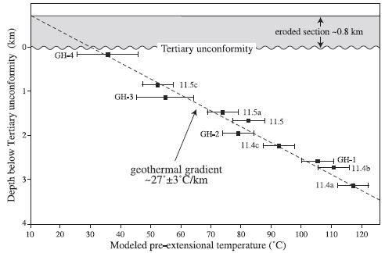
Apatite Fission Track and (U-Th)/He
Thickness of eroded section
Modeled temp (FT) vs depth below Tertiary unconformity
~0.8 km of pre-extensional overburden thickness
(U-TH)/He – Apatite (U-Th)/He partial retention zone (HePRZ)
New method for thermobarometry
Low-temp cooling histories for neotectonic and small-magnitude tectonic motions in upper crust
Age data collected for 11 samples
Agree with apatite fission track data
Notes:
Estimated from fission track modeling vs sample paleodepths below the Tertiary unconformity
Consistent with average regional thickness of volcanic and sedimentary overburden for onset of extension

Slide 8
Apatite Fission Track and (U-Th)/He
Thickness of eroded section
Modeled temp (FT) vs depth below Tertiary unconformity
~0.8 km of pre-extensional overburden thickness
(U-TH)/He – Apatite (U-Th)/He partial retention zone (HePRZ)
New method for thermobarometry
Low-temp cooling histories for neotectonic and small-magnitude tectonic motions in upper crust
Age data collected for 11 samples
Agree with apatite fission track data
Notes:
Estimated from fission track modeling vs sample paleodepths below the Tertiary unconformity
Consistent with average regional thickness of volcanic and sedimentary overburden for onset of extension

Slide 9
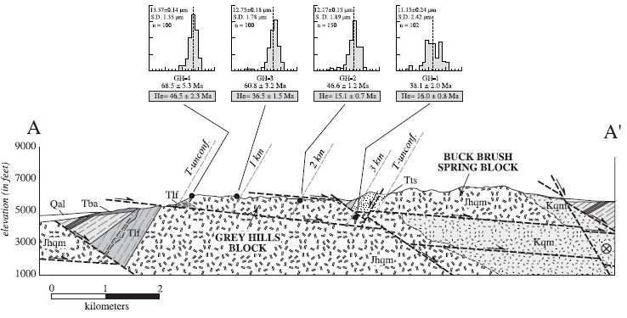
Apatite Fission Track and (U-Th)/He
Notes:
Apatite fission track length histograms and apparent ages
(U-Th)/He apparent ages (shaded boxes)
Ages increase to the west

Slide 10
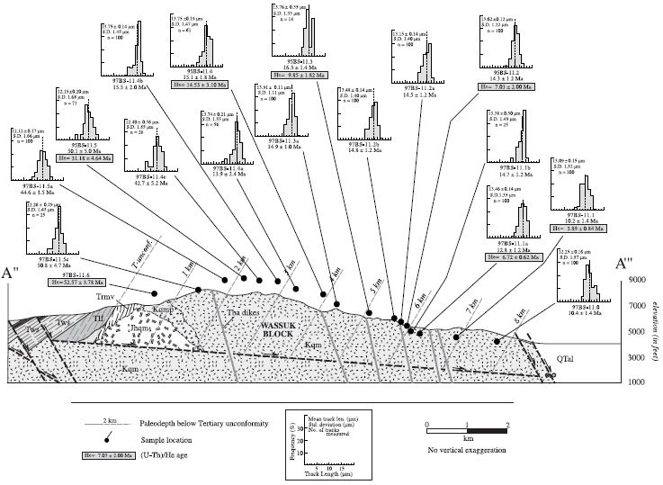
dsafsdf
Notes:
Apatite fission track length histograms and apparent ages
(U-Th)/He apparent ages (shaded boxes)
Ages increase to the west

Slide 11
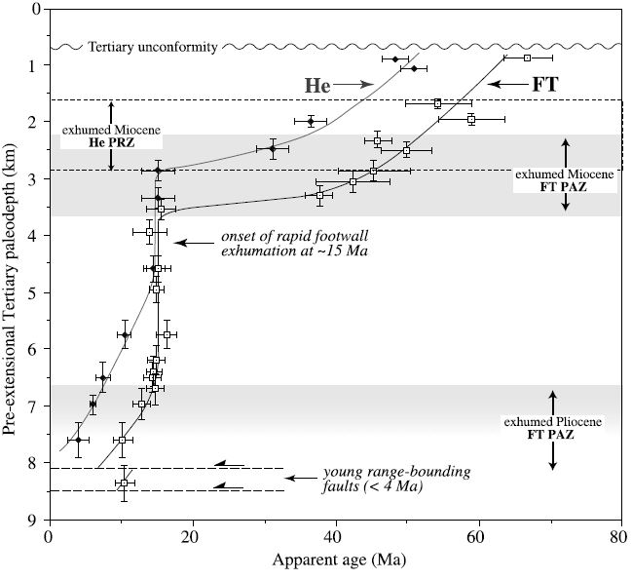
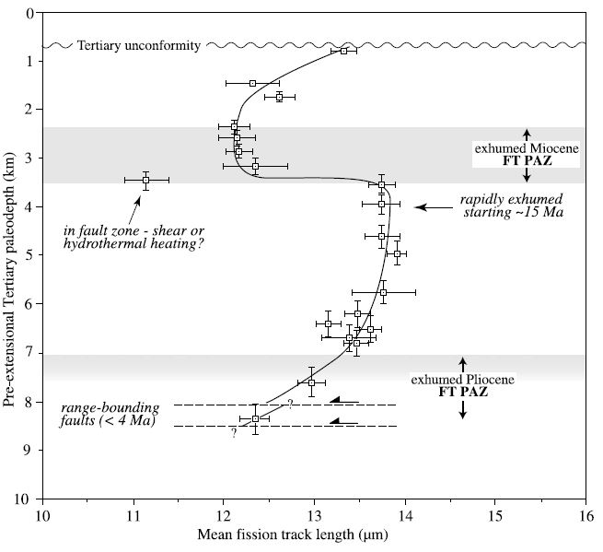
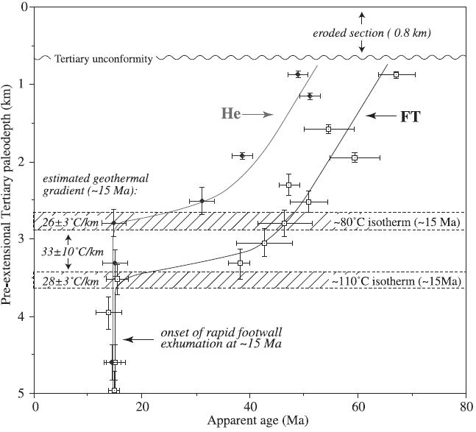
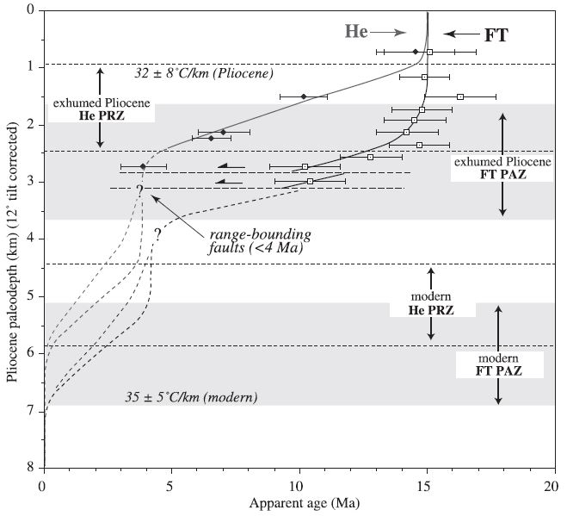
Miocene
Exhumation
History
1.
2.
3.
4.
Notes:
1. Fission track and (U-Th)/He thermochronological data (western)
Clear inflection points at ~15 Ma
Indicates onset of rapid cooling and exhumation
2. Suggestion of existence of two exhumed partially annealing zones
3. Miocene depth estimates to the inflection points at the base of the PAZ (60° C) and HePRZ (40° C)
Estimation of geothermal gradients prior to the onset of mid-Miocene extension
4. Eastern flank of western Wassuk range thermochronological data
Suggestion of ~4 Ma as the onset of significant Pliocene-Quaternary range front faulting

Slide 12
Miocene
Exhumation
History
1.
2.
3.
4.
Notes:
1. Fission track and (U-Th)/He thermochronological data
Clear inflection points at ~15 Ma
Indicates onset of rapid cooling and exhumation
2. Suggestion of existence of two exhumed partially annealing zones
3. Miocene depth estimates to the inflection points at the base of the PAZ (60° C) and HePRZ (40° C)
Estimation of geothermal gradients prior to the onset of mid-Miocene extension
4. Eastern flank of western Wassuk range thermochronological data
Suggestion of ~4 Ma as the onset of significant Pliocene-Quaternary range front faulting

Slide 13
Miocene
Exhumation
History
1.
2.
3.
4.
Notes:
1. Fission track and (U-Th)/He thermochronological data (western)
Clear inflection points at ~15 Ma
Indicates onset of rapid cooling and exhumation
2. Suggestion of existence of two exhumed partially annealing zones
3. Miocene depth estimates to the inflection points at the base of the PAZ (60° C) and HePRZ (40° C)
Estimation of geothermal gradients prior to the onset of mid-Miocene extension
4. Eastern flank of western Wassuk range thermochronological data
Suggestion of ~4 Ma as the onset of significant Pliocene-Quaternary range front faulting

Slide 14
Miocene
Exhumation
History
1.
2.
3.
4.
Notes:
1. Fission track and (U-Th)/He thermochronological data (western)
Clear inflection points at ~15 Ma
Indicates onset of rapid cooling and exhumation
2. Suggestion of existence of two exhumed partially annealing zones
3. Miocene depth estimates to the inflection points at the base of the PAZ (60° C) and HePRZ (40° C)
Estimation of geothermal gradients prior to the onset of mid-Miocene extension
4. Eastern flank of western Wassuk range thermochronological data
Suggestion of ~4 Ma as the onset of significant Pliocene-Quaternary range front faulting

Slide 15
Miocene
Exhumation
History
1.
2.
3.
4.
Notes:
1. Fission track and (U-Th)/He thermochronological data (western)
Clear inflection points at ~15 Ma
Indicates onset of rapid cooling and exhumation
2. Suggestion of existence of two exhumed partially annealing zones
3. Miocene depth estimates to the inflection points at the base of the PAZ (60° C) and HePRZ (40° C)
Estimation of geothermal gradients prior to the onset of mid-Miocene extension
4. Eastern flank of western Wassuk range thermochronological data
Suggestion of ~4 Ma as the onset of significant Pliocene-Quaternary range front faulting

Slide 16
Miocene
Exhumation
History
1.
2.
3.
4.
Notes:
1. Fission track and (U-Th)/He thermochronological data (western)
Clear inflection points at ~15 Ma
Indicates onset of rapid cooling and exhumation
2. Suggestion of existence of two exhumed partially annealing zones
3. Miocene depth estimates → Estimation of geothermal gradients prior to the onset of mid-Miocene extension
4. Eastern flank of western Wassuk range thermochronological data
Suggestion of ~4 Ma as the onset of significant Pliocene-Quaternary range front faulting

Slide 17
Miocene
Exhumation
History
1.
2.
3.
4.
Notes:
1. Fission track and (U-Th)/He thermochronological data (western)
Clear inflection points at ~15 Ma
Indicates onset of rapid cooling and exhumation
2. Suggestion of existence of two exhumed partially annealing zones
3. Miocene depth estimates → estimates of geothermal gradients prior to the onset of mid-Miocene extension
4. Eastern flank of western Wassuk range thermochronological data
Suggestion of ~4 Ma as the onset of significant Pliocene-Quaternary range front faulting

Slide 18
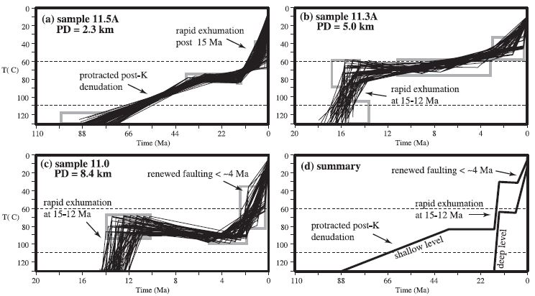
Modeling Results
(d) Complete exhumation and cooling history (Cretaceous to present)
dsf
Notes:
PD = Paleodepth
Summary – Fission track modeling for samples from different structural levels give:
Complete exhumation and cooling history (Cretaceous to Present)

Slide 19
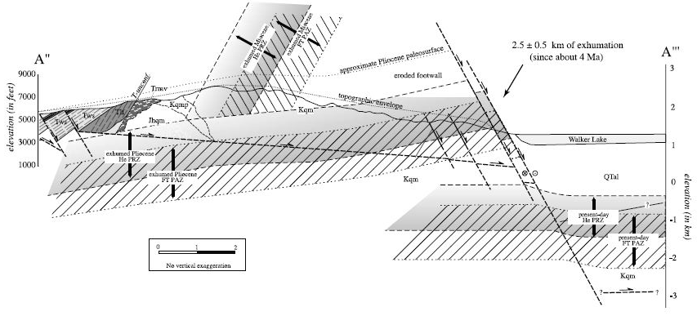
Discussion/Conclusions
Definition of two different exhumed fission track partial annealing and (U-Th)/He partial retention zones
Multiple episodes of Neogene extensional deformation of a westward fault block tilting ~60° about a NNW trending horizontal axis
Onset of cooling and exhumation at ~15 Ma and ends by ~12 Ma
Suggestion that Wassuk Range was part of Sierra Nevada magmatic arc prior to mid-Miocene extension
Notes:
Definition of two different exhumed fission track partial annealing and (U-Th)/He partial retention zones

Slide 20
Discussion/Conclusions
Second period of extensional deformation ~4 Ma – present day
Eastern flank of Wassuk Range
Miocene geothermal gradient → (27° ± 5° C/km)
Weakening of the crust prior to the onset of extension
Pliocene geothermal gradient → (32° ± 8° C/km)
Much reduced cooling rates and nearly isothermal conditions
Notes:
Definition of two different exhumed fission track partial annealing and (U-Th)/He partial retention zones
Difference in geothermal gradient could be attributed to crustal thinning and coeval mafic underplating beneath the western B&R

